Slide 1

Nested Tooltips Plugin
For Godot

Slide 2
Elevator Pitch
There is a trend in modern games to display more information to the user
Nested tooltips can be used to display information to a user on-demand and without overwhelming them
They worksby allowing users to enter an opened tooltip and then open another tooltip from within it

Slide 3
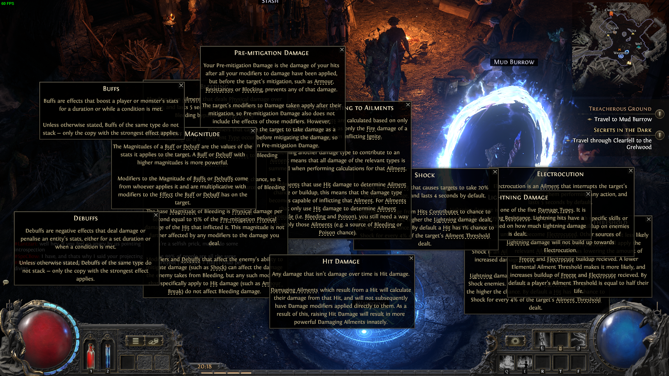
Examples

Slide 4
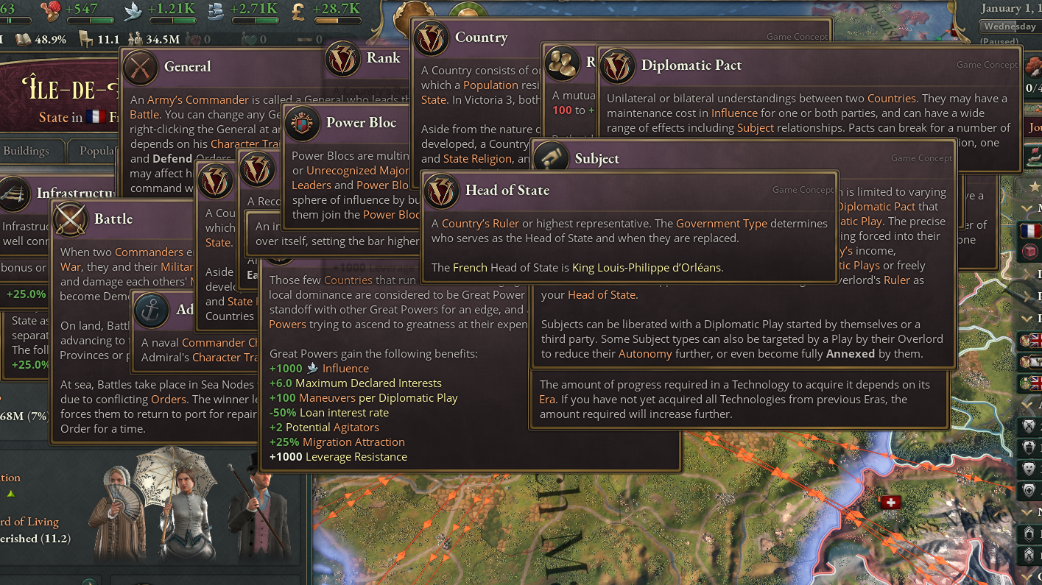
Examples

Slide 5
Interaction Loop
User opens tooltip
User can hover into tooltip
Tooltip is locked/pinned

Slide 6
Focus
Creating a simple and concise library that can be used in other (real) projects

Slide 7
Milestones
Getting a tooltip system without nesting to work (until 14.07.25)
Implementing the nesting, deserialization and placement logic (until 17.08.25)
Turning the library into a plugin and publishing it (until 29.08.25)
Creating a demo/presentation video (until 05.09.25)

